Slide 1
Formal Verification in the Game "Cops and Thieves"
Final Project Presentation
Asaf Ben Or
Yonatan Kupfer

Slide 2
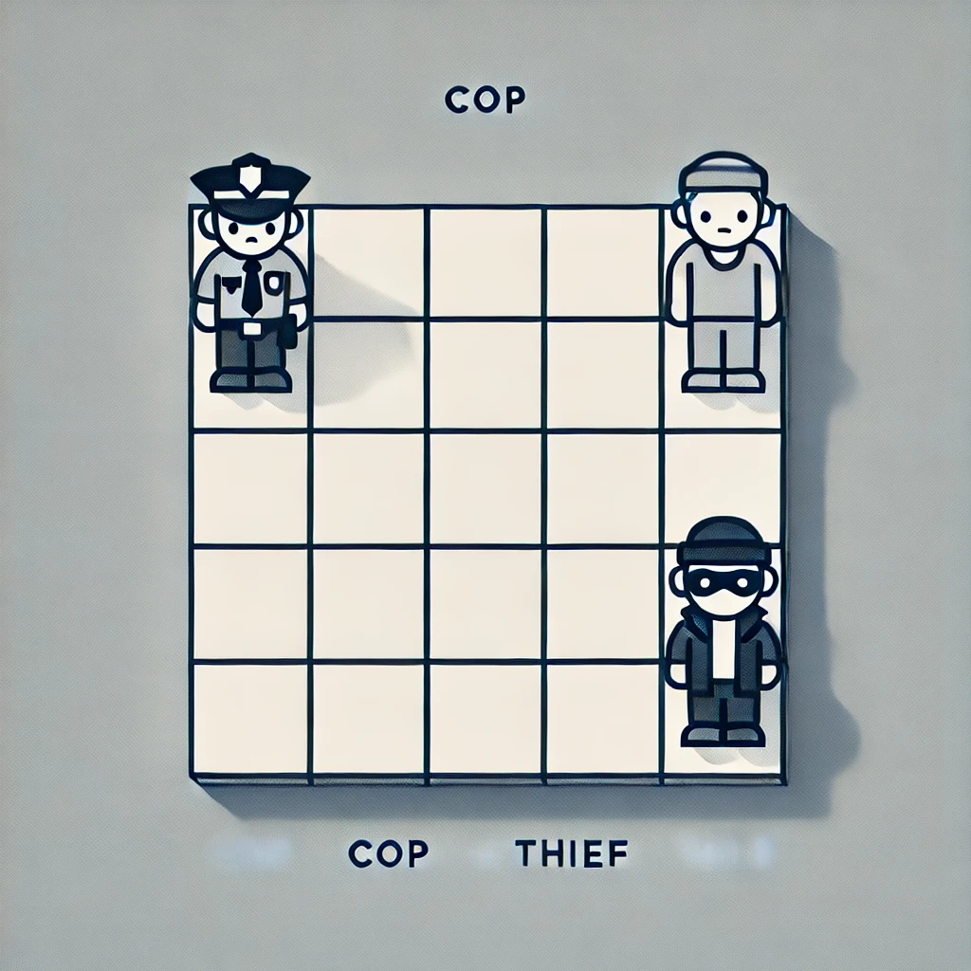
Introduction
This project applies formal verification to the "Cops and Thieves" game.
We use Python and nuXmv to analyze different strategies.
A GUI was built for interactive gameplay testing.

Slide 3
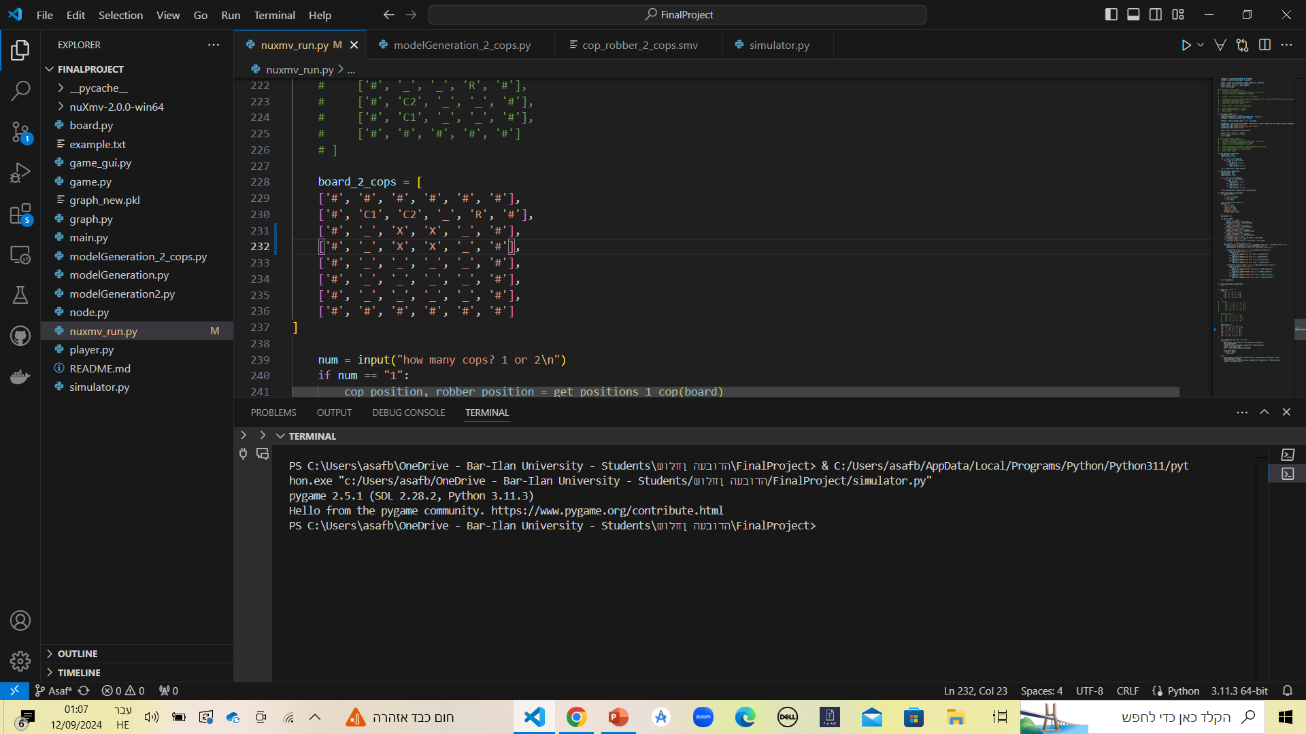
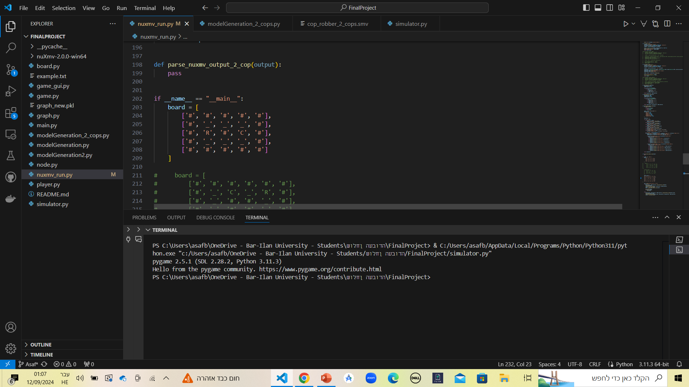
Game Concept
The game is played on a grid where one or more cops try to catch a thief.
The thief moves to escape, while the cops follow predefined strategies.
Our goal is to verify whether the cops’ strategies are effective in every situation.

Slide 4
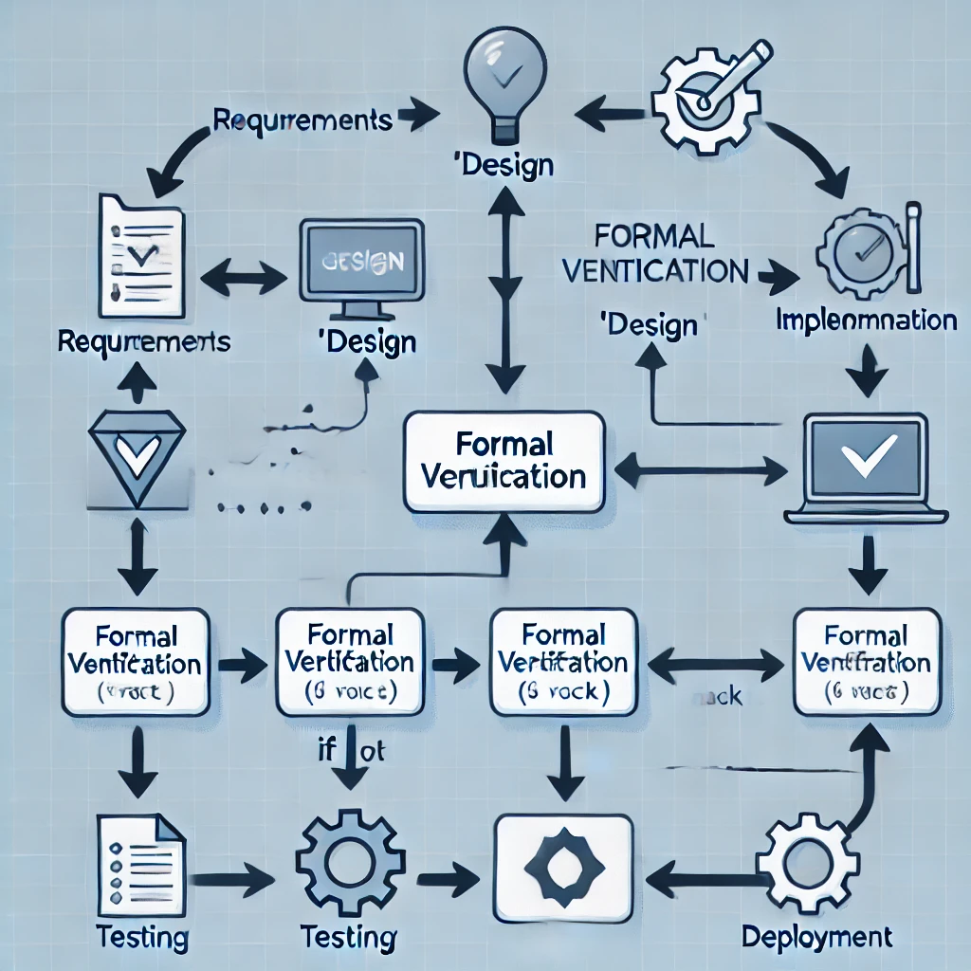
What is Formal Verification?
Formal verification uses mathematical methods to ensure the system behaves as expected.
Instead of testing a few cases, it proves that a strategy works under all possible scenarios.
This is especially useful in games with multiple strategies and outcomes.

Slide 5
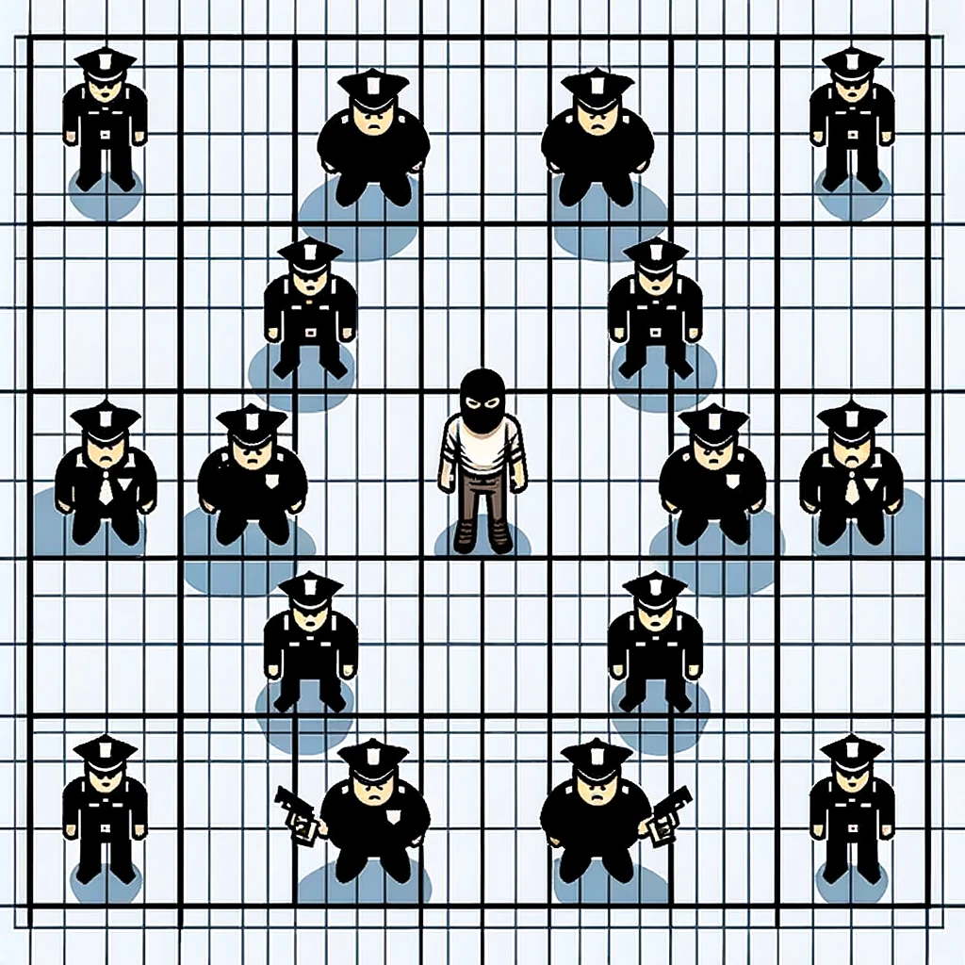
Relevance to Formal Verification
"Cops and Thieves" is an ideal case for formal verification due to its simplicity.
It has clear rules but complex interactions between cops and thief, making it challenging.
This complexity makes it a good model for testing verification methods.

Slide 6

Why nuXmv?
nuXmv is a powerful formal verification tool.
It allows us to model the game as a system and check all possible outcomes.
Using nuXmv, we can ensure that the cops’ strategies work in all cases, not just in selected scenarios.

Slide 7
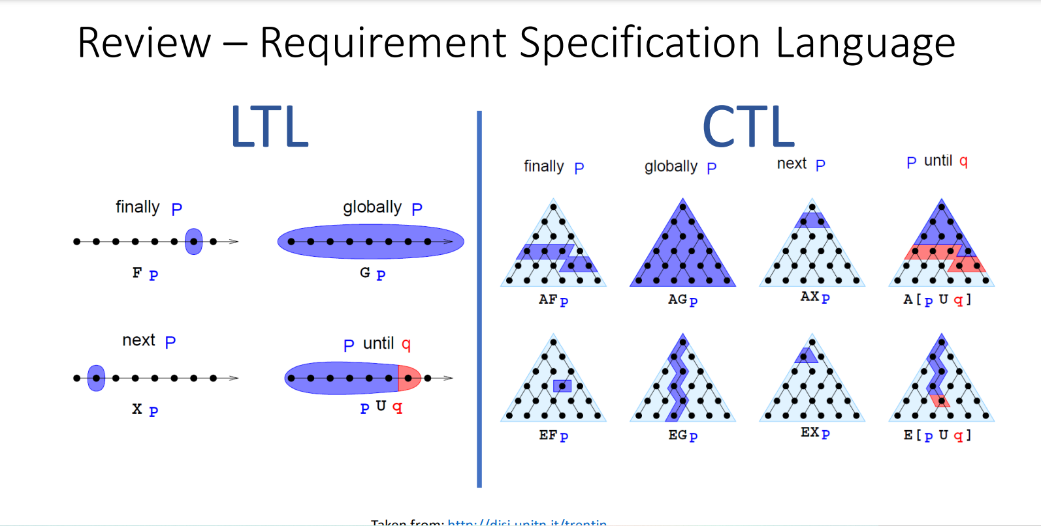

Slide 8

Reducing Manhattan Distance Strategy
Cops reduce the Manhattan distance to the thief by moving directly toward them.
This strategy minimizes the distance in both horizontal and vertical directions.
It’s a fast and straightforward method, often leading to quick captures but can leave escape routes open in some cases.

Slide 9
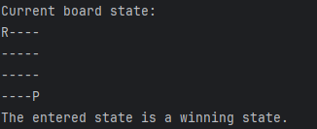
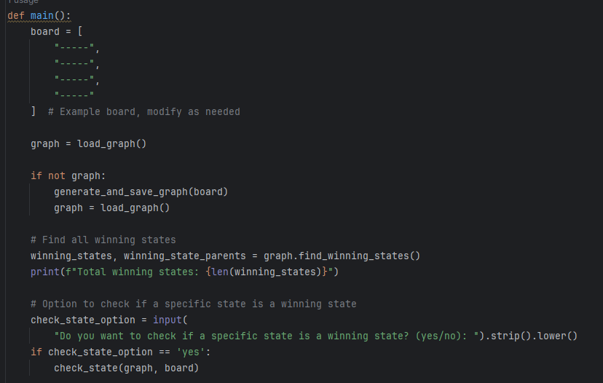
One Policeman – Python Analysis
Python is used to determine if a thief can escape from one cop.
We simulate different starting positions and movements.
The result is a binary: escape is either possible or not.

Slide 10
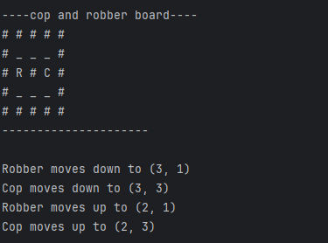
Verifying with nuXmv
After Python, we use nuXmv to formally verify the results.
This ensures that the cop’s strategy works under all conditions.
Formal verification provides a mathematical guarantee.

Slide 11
Two Policemen – Strategy 1: Reducing Manhattan Distance
In this strategy, cops reduce the Manhattan distance to the thief.
They move directly toward the thief, closing the gap.
This strategy is efficient but has some limitations.
Here will be GIF of the movement

Slide 12
Second Strategy: Going Around the Square
Strategy 2 involves the cops moving around the square in a coordinated way.
Instead of directly chasing the thief, they try to corner the thief by controlling the grid.
This strategy can be slower but can trap the thief more effectively in some cases.
Here will be GIF of the movement

Slide 13
Comparing the Strategies
Strategy 1: Reducing Manhattan distance is faster but can leave gaps.
Strategy 2: Going around the square takes more time but often traps the thief better.
Formal verification shows strengths and weaknesses of both strategies, depending on the scenario.

Slide 14
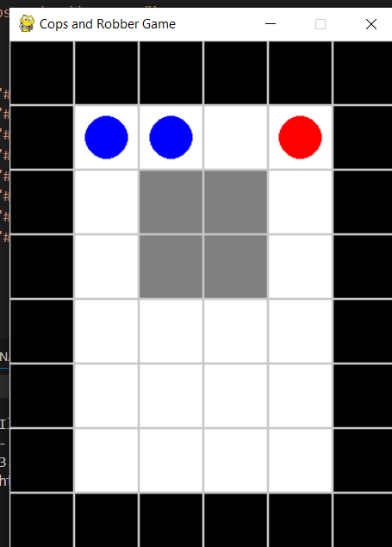
GUI Overview
We developed a GUI to let users interact with the game.
Players control the thief and try to escape the cops.
This interface makes the strategies visual and interactive, showing how formal verification plays out in real time.

Slide 15
How It Works: Interactive Demo

Slide 16

Challenges and Solutions
We faced challenges modeling multiple strategies for formal verification.
The GUI development also required careful integration with game logic.
Overcoming these issues improved both the analysis and user experience.

Slide 17

Future Work
Future work could explore more complex scenarios, like adding more cops or testing other planar graphs.
Future work could also optimize strategies and improve the GUI.
Expanding the project could lead to even deeper game analysis.

Slide 18

Conclusion
We verified two different strategies in Cops and Thieves using formal methods.
Python and nuXmv helped us ensure correctness.
The interactive GUI lets players test the strategies themselves.

